Slide 1


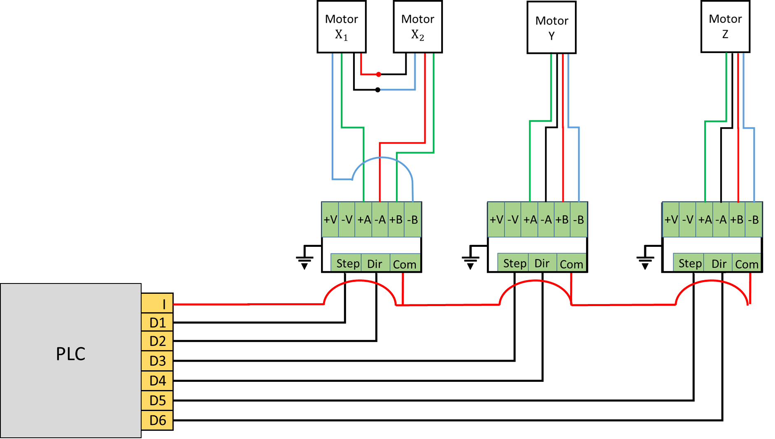
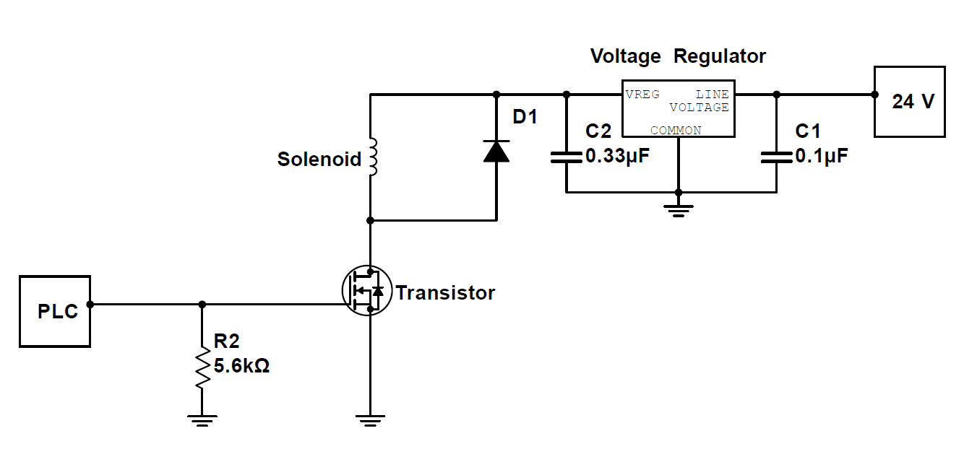
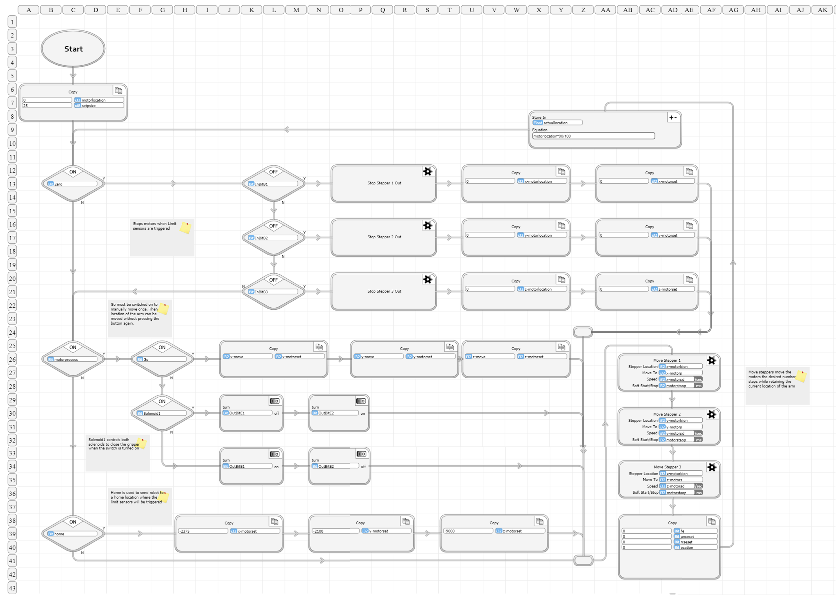


Soft Robotic Actuator
David Camparmo
Department of Physics, Kwantlen Polytechnic University
What is soft Robotics
Circuit Diagrams
A subfield of robotics that focuses on the design, control, and fabrication of robots of comprised flexible materials.
Though rigid body robots can have soft components such as shock absorbing joint, soft robotics generally refers to machines that are predominately or completely soft
This focus on this project was to design and build a Cartesian robot for the purpose of testing soft pneumatic actuators
These diagrams are for the circuits that make up the robot. The left most diagrams show how the stepper motors which control movement are connected to the PLC, and the second diagrams shows the circuit which allows the solenoids to be controlled with the PLC
Made using vBuilder
Flow Based Code
This robot uses flow logic to controls movements of the arm along with opening and closing the actuator. This code dictates how manual control works, from moving the robot along the Cartesian plane, to activating the solenoids that control the actuator, and returning the home position.
The code was built using Velocio vbuilder and is controlled through a user interface created with vFactory.
Once the code is complete it is copied onto the Programmable Logic Controller (PLC). Where it can instruct the to move to a desired location based on inputs from the user interface.
Applications of Soft Robotics
Continuation of Project
Manufacturing
Bio-mimicry
Prosthetics limbs
Surgical assistance
Wearable Robots
With the robot being contracted there are many avenues for future students to continue the project. One example is creating an automated program to move an object from one place to another. Or designing different actuators and testing their capabilities.

